Slide 2
Exodus 20:13
New Living Translation
You must not murder.

Slide 3
What It DOESN’T Say:
You must not kill

Slide 4
What It DOESN’T Say:
You must not kill
It doesn’t forbid killing animals

Slide 5
What It DOESN’T Say:
You must not kill
It doesn’t forbid killing animals
It is not a prohibition against war

Slide 7
A Story
about a
turtle…

Slide 8
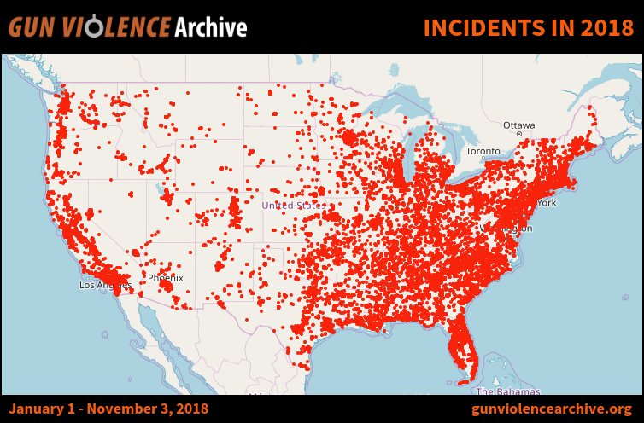

Slide 9
So what is it about?
Human Life is Precious

Slide 10
Genesis 1:26
New Living Translation
Then God said, “Let us make human beings in our image, to be like us.

Slide 11
Genesis 2:7
New Living Translation
Then the Lord God formed the man from the dust of the ground. He breathed the breath of life into the man’s nostrils, and the man became a living person.

Slide 12
Romans 5:8
“God demonstrates His own love — He shows how much He valued human life in this — while we were still sinners, Christ died for us.”

Slide 13
Matthew 5:21-22
New Living Translation
²¹ “You have heard that our ancestors were told, ‘You must not murder. If you commit murder, you are subject to judgment.’²² But I say, if you are even angry with someone, you are subject to judgment! If you call someone an idiot, you are in danger of being brought before the court. And if you curse someone, you are in danger of the fires of hell.

