Slide 2
Exodus 20:12
New Living Translation
Honor your father and mother. Then you will live a long, full life in the land the Lord your God is giving you.

Slide 4
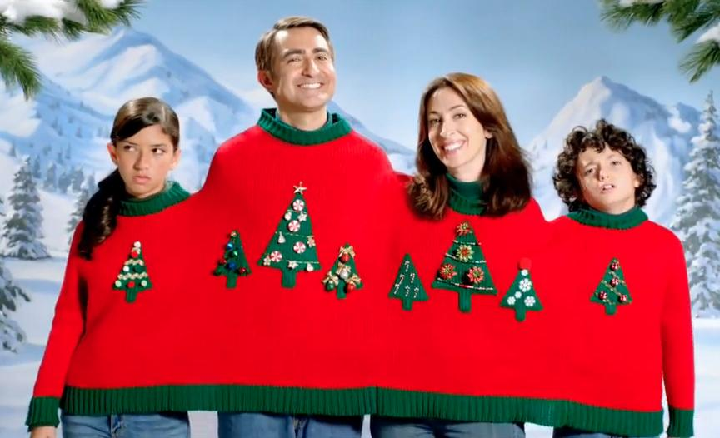

Slide 6
Matthew 5:44-45a, 46-47a
New Living Translation
⁴⁴ But I say, love your enemies! Pray for those who persecute you! ⁴⁵ In that way, you will be acting as true children of your Father in heaven. ...

Slide 7
Matthew 5:44-45a, 46-47a
New Living Translation
⁴⁶ If you love only those who love you, what reward is there for that? Even corrupt tax collectors do that much. ⁴⁷ If you are kind only to your friends, how are you different from anyone else?

Slide 8
Honour Your Parents
WHY?

Slide 9
Honour Your Parents
Because God Commands It
Gratitude

Slide 10
Average Cost of Raising Kids in Australia:
(According to the Australian Institute for Family Studies - April 2018)
For Low-Income Families: $170 p.w.
= $159,120 per child

Slide 11
Honour Your Parents
Because God Commands It
Gratitude
To Avoid Their Mistakes

Slide 12
Honour = A Heavy Weight
Dishonour = To Take Lightly

Slide 13
Proverbs 1:8
New Living Translation
My child, listen when your father corrects you. Don’t neglect your mother’s instruction.

Slide 14
PARENTS: Live in a way that is worthy of honour

Slide 15
Colossians 3:20-21
New Living Translation
²⁰ Children, always obey your parents, for this pleases the Lord. ²¹ Fathers, do not aggravate your children, or they will become discouraged.

Slide 16
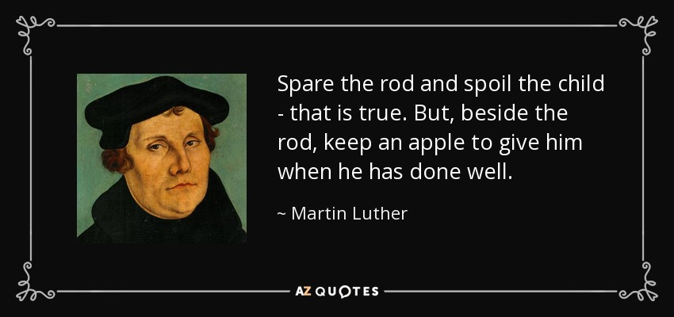

Slide 17
Honour Your Parents
HOW?

Slide 18
Honour Your Parents
Love Them

Slide 19
Honour Your Parents
Love Them
Forgive Them

