Slide 2
Exodus 20:7
New Living Translation
“You must not misuse the name of the Lord your God. The Lord will not let you go unpunished if you misuse his name.

Slide 4
What’s In A Name?

Slide 6
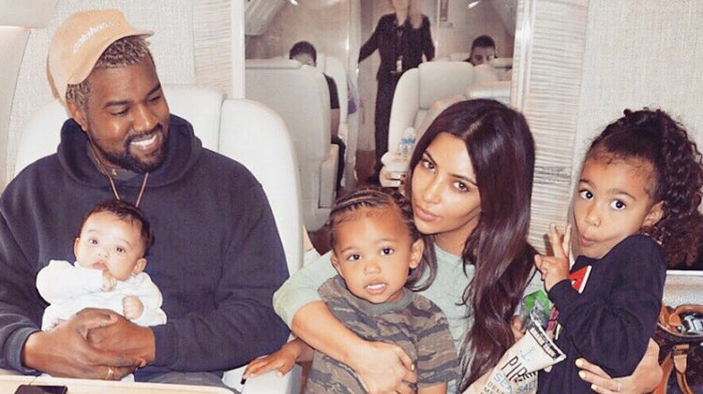

Slide 7
God’s Name is associated with His PRESENCE

Slide 8
Deuteronomy 12:11a
New English Translation
Then you must come to the place the Lord your God chooses for his Name to reside, bringing everything I am commanding you...

Slide 9
God’s Name is associated with His PROTECTION

Slide 10
Proverbs 18:10
New Living Translation
The name of the Lord is a strong fortress; the godly run to him and are safe.

Slide 11
God’s Name is associated with His SALVATION

Slide 12
Romans 10:13
New Living Translation
For “Everyone who calls on the name of the Lord will be saved.”

Slide 13
No Ordinary Name

Slide 14
Acts 4:12
New Living Translation
There is salvation in no one else! God has given no other name under heaven by which we must be saved.

Slide 15
Philippians 2:9-11
New Living Translation
Therefore, God elevated him to the place of highest honor and gave him the name above all other names, ¹⁰ that at the name of Jesus every knee should bow, in heaven and on earth and under the earth, ¹¹ and every tongue declare that Jesus Christ is Lord, to the glory of God the Father.

Slide 16
Why Does It Matter?
1. There are consequences for Us
2. There are consequences for Others

