Slide 2
Exodus 20:4-6
New Living Translation
“You must not make for yourself an idol of any kind or an image of anything in the heavens or on the earth or in the sea. ⁵ You must not bow down to them or worship them, for I, the Lord your God, am a jealous God who will not tolerate your affection for any other gods.

Slide 3
Exodus 20:4-6
New Living Translation
I lay the sins of the parents upon their children; the entire family is affected—even children in the third and fourth generations of those who reject me. ⁶ But I lavish unfailing love for a thousand generations on those who love me and obey my commands.

Slide 4
Exodus 20:2-3
New Living Translation
² “I am the Lord your God, who rescued you from the land of Egypt, the place of your slavery. ³ You must not have any other god but me.

Slide 5
Substitutes
Steve
Irwin

Slide 6
Substitutes
Marilyn
Monroe

Slide 7
Substitutes
Mr Bean

Slide 8
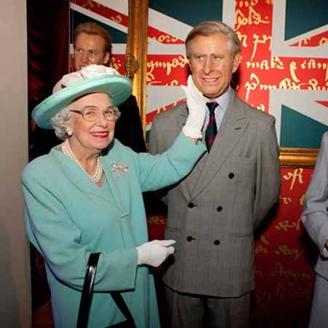
Substitutes
The Queen

Slide 9
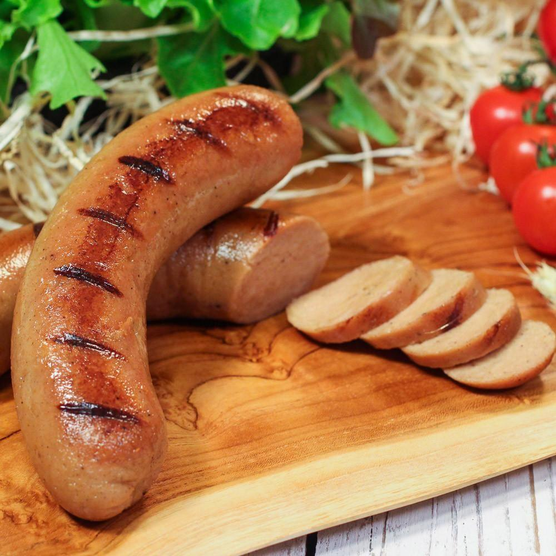
Substitutes
Vegan Sausage

Slide 10
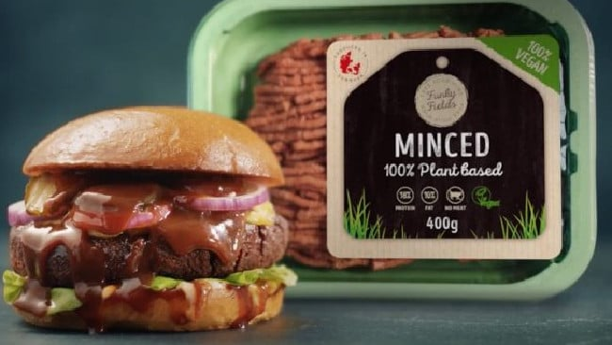
Substitutes
“Minced”

Slide 11
Substitutes

Slide 12
Substitutes
The Counterfeit Goods industry was worth an estimated
USD - $1,200,000,000,000
in 2017!

Slide 13
This second law insists that the object of our worship must never be something of our own construction or something that is under our control.

Slide 14
Romans 1:21-23
The Passion Translation
²¹ Throughout human history the fingerprints of God were upon them, yet they refused to honor him as God or even be thankful for his kindness. Instead, they entertained corrupt and foolish thoughts about what God was like. This left them with nothing but misguided hearts, steeped in moral darkness.

Slide 15
Romans 1:21-23
New Living Translation
²² Although claiming to be super-intelligent, they were in fact shallow fools. ²³ For only a fool would trade the unfading splendor of the immortal God to worship the fading image of other humans, idols made to look like people, animals, birds, and even creeping reptiles!

Slide 16
Romans 1:25
New Living Translation
They worshiped and served the things God made rather than the God who made all things...

Slide 17
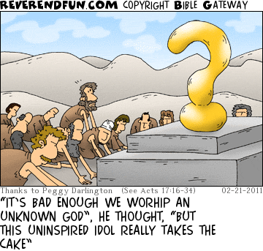

Slide 18
Modern Idols
SELF – Selfies, Self-help books, Facebook Likes, Fashion, Body Alterations
MATERIALISM – Pursuit of wealth, Money, Possessions, Technology, Upgrades, Comfort, Career, House, Car, etc.

Slide 19
Modern Idols
CELEBRITIES – Idolisation of People, Movie stars, Singers/Musicians, Sports Stars, Royalty
FREEDOM / PERSONAL HAPPINESS – “I have the right to decide for myself how to live my life and pursue my own happiness.”

Slide 20
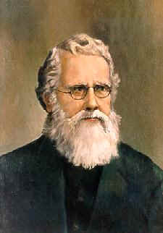
Hudson Taylor

Slide 21
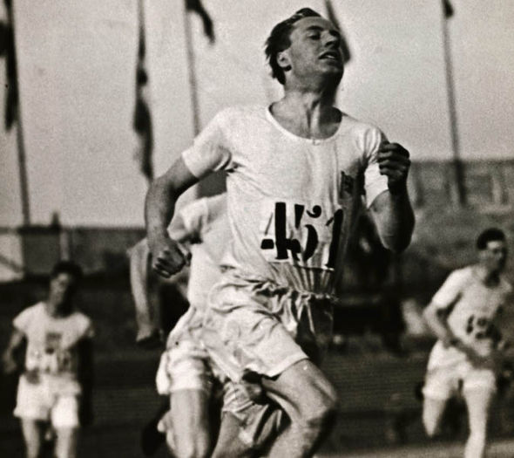
Eric Liddell

Slide 22
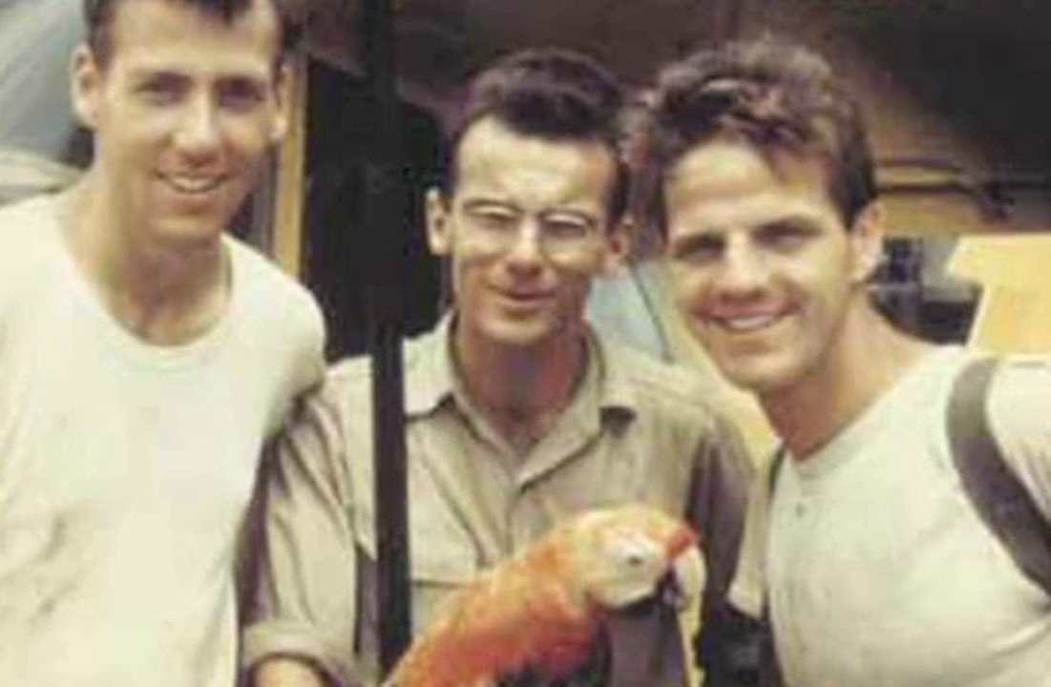
Jim Elliot
(right)

Slide 23
Why Does God Hate Idolatry?
1. It Steals our Freedom
2. It Hurts our Children
3. Our Idols Shape our Lives

Slide 24
Jeremiah 2:5
New Living Translation
This is what the Lord says: “What did your ancestors find wrong with me that led them to stray so far from me? They worshiped worthless idols, only to become worthless themselves.

Slide 25
Romans 8:29
New Living Translation
For God knew his people in advance, and he chose them to become like his Son...

Slide 26
Why Does God Hate Idolatry?
1. It Steals our Freedom
2. It Hurts our Children
3. Our Idols Shape our Lives
4. It Hurts God

Slide 27
Exodus 20:5
New Living Translation
"... I, the Lord your God, am a jealous God who will not tolerate your affection for any other gods."

