Slide 2
We need God’s wisdom
It’s easy to misunderstand

Slide 3
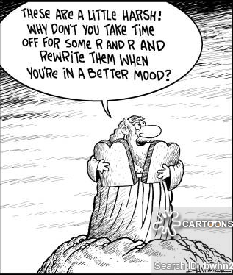

Slide 4
The Ten Commandments
#1 - No other god
#2 - Do not worship anything material as God
#3 - God's name is not to be used disrespectfully
#4 - Remember the Sabbath (Day of Rest)
#5 - Honour your mother and father
#6 - Do not murder
#7 - Do not commit adultery
#8 - Do not steal
#9 - Do not testify falsely about anyone
#10 - Do not be jealous of what others have
How we relate to God
How we relate to others

Slide 5
Matthew 22:37-40
New Living Translation
³⁷ Jesus replied, “‘You must love the Lord your God with all your heart, all your soul, and all your mind.’ ³⁸ This is the first and greatest commandment. ³⁹ A second is equally important: ‘Love your neighbor as yourself.’ ⁴⁰ The entire law and all the demands of the prophets are based on these two commandments.”

Slide 6
Exodus 20:2-3
New Living Translation
² “I am the Lord your God, who rescued you from the land of Egypt, the place of your slavery. ³ You must not have any other god but me.

Slide 8
Gods of Egypt
Ra

Slide 9
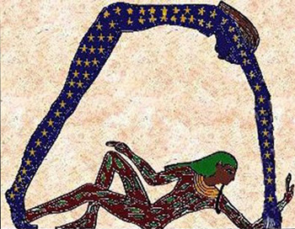
Gods of Egypt
Geb & Nut

Slide 10
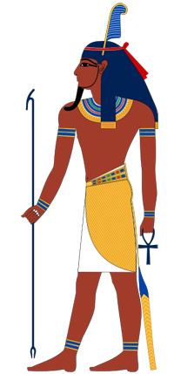
Gods of Egypt
Shu

Slide 11
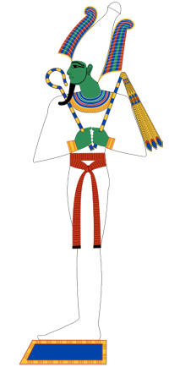
Gods of Egypt
Osiris & Isis

Slide 12
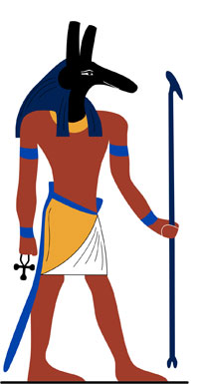
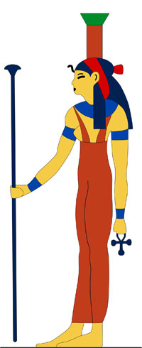
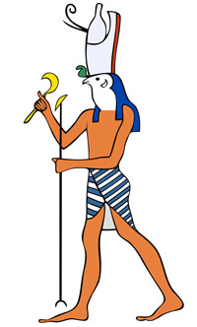
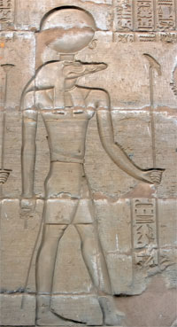
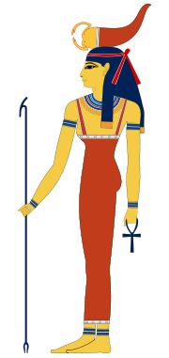
Gods of Egypt
Set
Nephthys
Horus
Sobek
Serqet
And so on... 2000+

Slide 13
Exodus 20:2-3
New Living Translation
² “I am the Lord your God, who rescued you from the land of Egypt, the place of your slavery. ³ You must not have any other god but me.

Slide 14
Revelation 2:4
New Living Translation
But I have this complaint against you. You don’t love me or each other as you did at first!

Slide 15
1 Peter 5:7
New Living Translation
Cast all your anxiety on Him because he cares for you.

Slide 16
Matthew 6:31-33
New Living Translation
³¹ “So don’t worry about these things, saying, ‘What will we eat? What will we drink? What will we wear?’ ³² These things dominate the thoughts of unbelievers, but your heavenly Father already knows all your needs. ³³ Seek the Kingdom of God above all else, and live righteously, and he will give you everything you need.

