Slide 2
Exodus 20:1-17
New Living Translation
Then God gave the people all these instructions:
² “I am the Lord your God, who rescued you from the land of Egypt, the place of your slavery. ³ “You must not have any other god but me.

Slide 3
Exodus 20:1-17
New Living Translation
⁴ “You must not make for yourself an idol of any kind or an image of anything in the heavens or on the earth or in the sea. ⁵ You must not bow down to them or worship them, for I, the Lord your God, am a jealous God who will not tolerate your affection for any other gods.

Slide 4
Exodus 20:1-17
New Living Translation
I lay the sins of the parents upon their children; the entire family is affected—even children in the third and fourth generations of those who reject me. ⁶ But I lavish unfailing love for a thousand generations on those who love me and obey my commands.

Slide 5
Exodus 20:1-17
New Living Translation
⁷ “You must not misuse the name of the Lord your God. The Lord will not let you go unpunished if you misuse his name.
⁸ “Remember to observe the Sabbath day by keeping it holy. ⁹ You have six days each week for your ordinary work, ¹⁰ but the seventh day is a Sabbath day of rest dedicated to the Lord your God.

Slide 6
Exodus 20:1-17
New Living Translation
On that day no one in your household may do any work. This includes you, your sons and daughters, your male and female servants, your livestock, and any foreigners living among you. ¹¹ For in six days the Lord made the heavens, the earth, the sea, and everything in them; but on the seventh day he rested. That is why the Lord blessed the Sabbath day and set it apart as holy.

Slide 7
Exodus 20:1-17
New Living Translation
On that day no one in your household may do any work. This includes you, your sons and daughters, your male and female servants, your livestock, and any foreigners living among you. ¹¹ For in six days the Lord made the heavens, the earth, the sea, and everything in them; but on the seventh day he rested. That is why the Lord blessed the Sabbath day and set it apart as holy.

Slide 8
Exodus 20:1-17
New Living Translation
¹² “Honor your father and mother. Then you will live a long, full life in the land the Lord your God is giving you.
¹³ “You must not murder.
¹⁴ “You must not commit adultery.
¹⁵ “You must not steal.

Slide 9
Exodus 20:1-17
New Living Translation
¹⁶ “You must not testify falsely against your neighbor.
¹⁷ “You must not covet your neighbor’s house. You must not covet your neighbor’s wife, male or female servant, ox or donkey, or anything else that belongs to your neighbor.”

Slide 10
Why should I care?

Slide 11
2 Timothy 3:16-17
New Living Translation
All Scripture is inspired by God and is useful to teach us what is true and to make us realize what is wrong in our lives. It corrects us when we are wrong and teaches us to do what is right. ¹⁷ God uses it to prepare and equip his people to do every good work.

Slide 12
Romans 6:1-2
New Living Translation
Well then, should we keep on sinning so that God can show us more and more of his wonderful grace? ² Of course not! Since we have died to sin, how can we continue to live in it?

Slide 13
Matthew 28:20a
New Living Translation
Teach these new disciples to obey all the commands I have given you.

Slide 14
Matthew 5:14-16
New Living Translation
¹⁴ “You are the light of the world—like a city on a hilltop that cannot be hidden. ¹⁵ No one lights a lamp and then puts it under a basket. Instead, a lamp is placed on a stand, where it gives light to everyone in the house. ¹⁶ In the same way, let your good deeds shine out for all to see, so that everyone will praise your heavenly Father.

Slide 15
We need to be reminded of God’s standard

Slide 16
Proverbs 3:7
New Living Translation
Don’t be impressed with your own wisdom. Instead, fear the Lord and turn away from evil.

Slide 17
We often misunderstand God’s intent

Slide 18
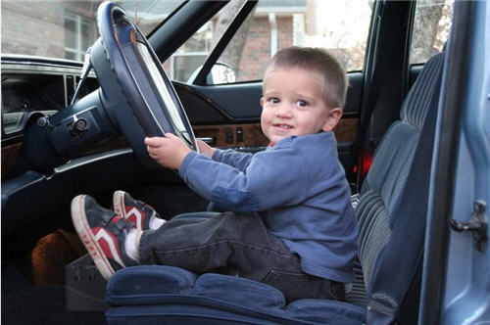

Slide 19
Exodus 19:3-6
New Living Translation
³ Then Moses climbed the mountain to appear before God. The Lord called to him from the mountain and said, “Give these instructions to the family of Jacob; announce it to the descendants of Israel: ⁴ ‘You have seen what I did to the Egyptians. You know how I carried you on eagles’ wings and brought you to myself.

Slide 20
Exodus 19:3-6
New Living Translation
⁵ Now if you will obey me and keep my covenant, you will be my own special treasure from among all the peoples on earth; for all the earth belongs to me. ⁶ And you will be my kingdom of priests, my holy nation.’ This is the message you must give to the people of Israel.”

Slide 21
1 John 5:3
New Living Translation
Loving God means keeping his commandments, and his commandments are not burdensome.

Slide 22
Matthew 11:30
New Living Translation
For my yoke is easy to bear, and the burden I give you is light.

