Slide 1
Learning to ask ourselves the right questions

Slide 2
Ask Siri

Slide 7
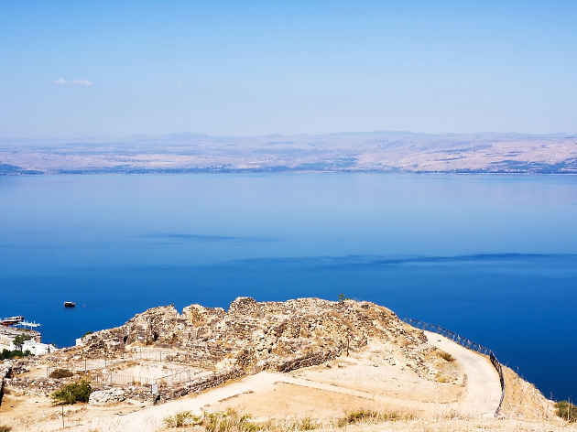
Sea of Galilee

Slide 8
Mark 4:35-41
New Living Translation
³⁵ As evening came, Jesus said to his disciples, “Let’s cross to the other side of the lake.” ³⁶ So they took Jesus in the boat and started out, leaving the crowds behind (although other boats followed). ³⁷ But soon a fierce storm came up. High waves were breaking into the boat, and it began to fill with water.
?

Slide 9
Mark 4:35-41
New Living Translation
³⁸ Jesus was sleeping at the back of the boat with his head on a cushion. The disciples woke him up, shouting, “Teacher, don’t you care that we’re going to drown?”
³⁹ When Jesus woke up, he rebuked the wind and said to the waves, “Silence! Be still!” Suddenly the wind stopped, and there was a great calm.
?

Slide 10
Mark 4:35-41
New Living Translation
⁴⁰ Then he asked them, “Why are you afraid? Do you still have no faith?”
⁴¹ The disciples were absolutely terrified. “Who is this man?” they asked each other. “Even the wind and waves obey him!”
?

Slide 11
