Slide 1
Learning to ask ourselves the right questions

Slide 3
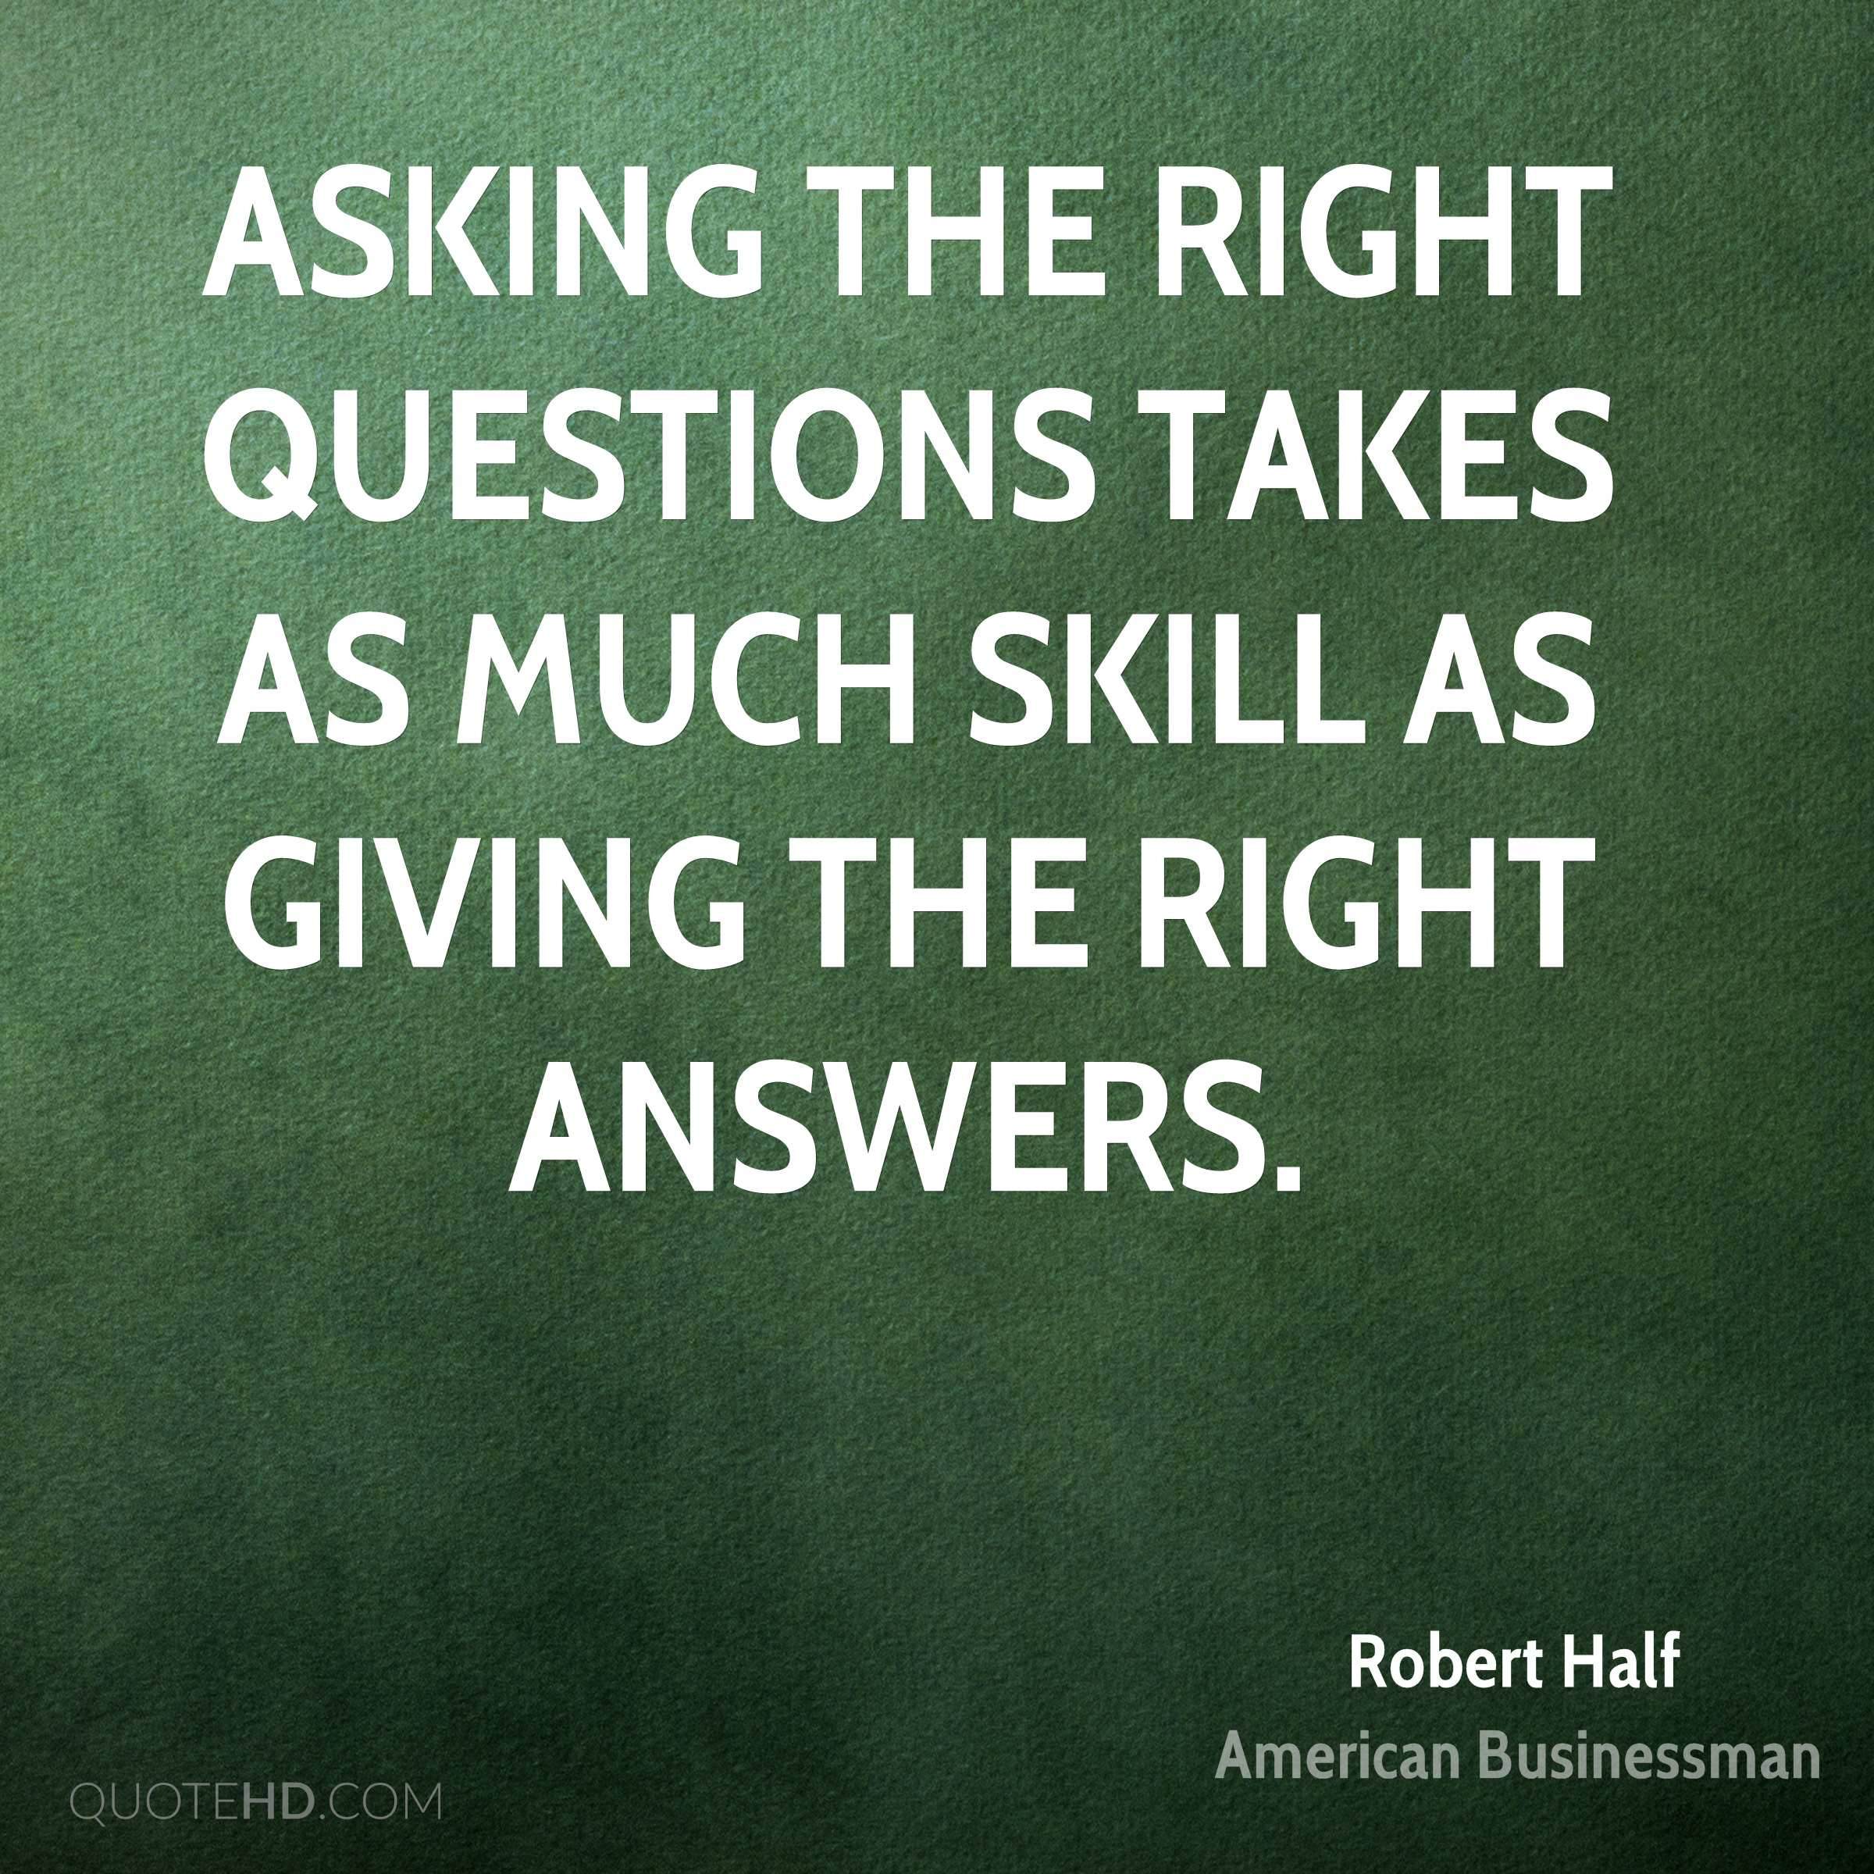

Slide 4
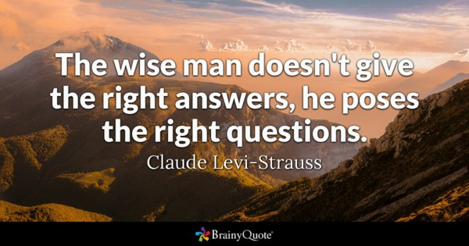

Slide 5
Ask Siri

Slide 8
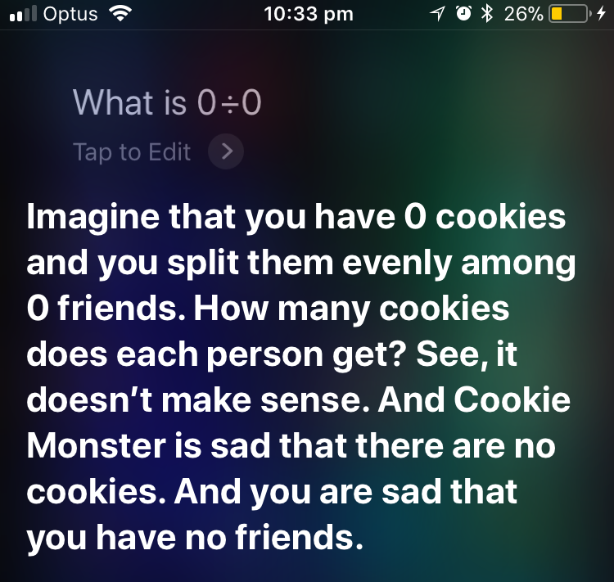

Slide 9
John 1:35-39
New Living Translation
³⁵ The following day John was again standing with two of his disciples. ³⁶ As Jesus walked by, John looked at him and declared, “Look! There is the Lamb of God!” ³⁷ When John’s two disciples heard this, they followed Jesus.
³⁸ Jesus looked around and saw them following. “What do you want?” he asked them.
They replied, “Rabbi” (which means “Teacher”), “where are you staying?”
?

Slide 10
John 1:35-39
New Living Translation
³⁹ “Come and see,” he said. It was about four o’clock in the afternoon when they went with him to the place where he was staying, and they remained with him the rest of the day.
?

Slide 11
Mark 10:35-40
New International Version
³⁵ Then James and John, the sons of Zebedee, came to him. “Teacher,” they said, “we want you to do for us whatever we ask.”
³⁶ “What do you want me to do for you?” he asked.
³⁷ They replied, “Let one of us sit at your right and the other at your left in your glory.”
³⁸ “You don’t know what you are asking,” Jesus said. “Can you drink the cup I drink or be baptized with the baptism I am baptized with?”
?

Slide 12
Mark 10:35-40
New International Version
³⁹ “We can,” they answered.
Jesus said to them, “You will drink the cup I drink and be baptized with the baptism I am baptized with, ⁴⁰ but to sit at my right or left is not for me to grant. These places belong to those for whom they have been prepared.”
?

Slide 13
Mark 10:46-52
New Living Translation
⁴⁶ Then they reached Jericho, and as Jesus and his disciples left town, a large crowd followed him. A blind beggar named Bartimaeus (son of Timaeus) was sitting beside the road. ⁴⁷ When Bartimaeus heard that Jesus of Nazareth was nearby, he began to shout, “Jesus, Son of David, have mercy on me!”
⁴⁸ “Be quiet!” many of the people yelled at him.
But he only shouted louder, “Son of David, have mercy on me!”
?

Slide 14
Mark 10:46-52
New Living Translation
⁴⁹ When Jesus heard him, he stopped and said, “Tell him to come here.”
So they called the blind man. “Cheer up,” they said. “Come on, he’s calling you!” ⁵⁰ Bartimaeus threw aside his coat, jumped up, and came to Jesus. ⁵¹ “What do you want me to do for you?” Jesus asked. “My Rabbi,” the blind man said, “I want to see!”
⁵² And Jesus said to him, “Go, for your faith has healed you.” Instantly the man could see, and he followed Jesus down the road.
?

Slide 15
Matthew 7:7-11
New Living Translation
⁷ “Keep on asking, and you will receive what you ask for. Keep on seeking, and you will find. Keep on knocking, and the door will be opened to you. ⁸ For everyone who asks, receives. Everyone who seeks, finds. And to everyone who knocks, the door will be opened.
?

Slide 16
Matthew 7:7-11
New Living Translation
⁹ “You parents—if your children ask for a loaf of bread, do you give them a stone instead? ¹⁰ Or if they ask for a fish, do you give them a snake? Of course not! ¹¹ So if you sinful people know how to give good gifts to your children, how much more will your heavenly Father give good gifts to those who ask him.
?

