Slide 1
Learning to ask ourselves the right questions

Slide 2
Ask Siri

Slide 6
John 5:1-9
New International Version
Some time later, Jesus went up to Jerusalem for one of the Jewish festivals. ² Now there is in Jerusalem near the Sheep Gate a pool, which in Aramaic is called Bethesda and which is surrounded by five covered colonnades. ³ Here a great number of disabled people used to lie—the blind, the lame, the paralyzed.
?

Slide 7
John 5:3b-4 – The Missing Verse?
New International Version
...and they waited for the moving of the waters. ⁴ From time to time an angel of the Lord would come down and stir up the waters. The first one into the pool after each such disturbance would be cured of whatever disease they had.
?

Slide 8
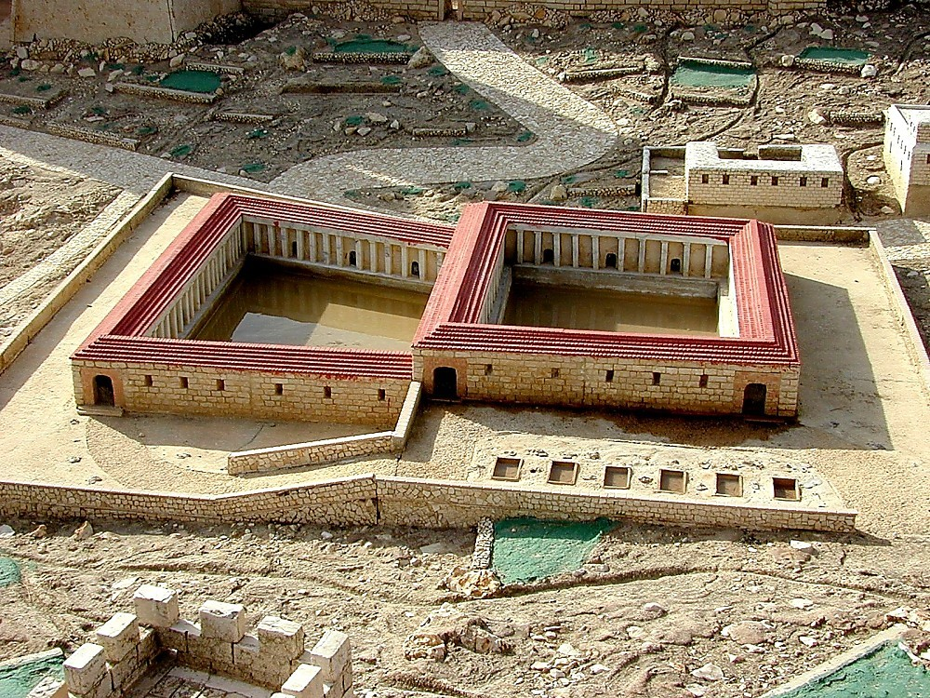
The Pool of Bethesda

Slide 9
John 5:5-7
New International Version
⁵ One who was there had been an invalid for thirty-eight years. ⁶ When Jesus saw him lying there and learned that he had been in this condition for a long time, he asked him, “Do you want to get well?”
^{7 “}Sir,” the invalid replied, “I have no one to help me into the pool when the water is stirred. While I am trying to get in, someone else goes down ahead of me.”
?

Slide 10
The longer a problem persists:
…the more discouraged you become
?

Slide 11
The longer a problem persists:
…the more discouraged you become
...the more excuses you make
?

Slide 12
The longer a problem persists:
…the more discouraged you become
...the more excuses you make
...the more you learn to compensate
?

Slide 13
John 5:8-9
New International Version
⁸ Then Jesus said to him, “Get up! Pick up your mat and walk.” ⁹ At once the man was cured; he picked up his mat and walked.
?

