Slide 1
PART 3:
Daring to Give God My Best

Slide 2
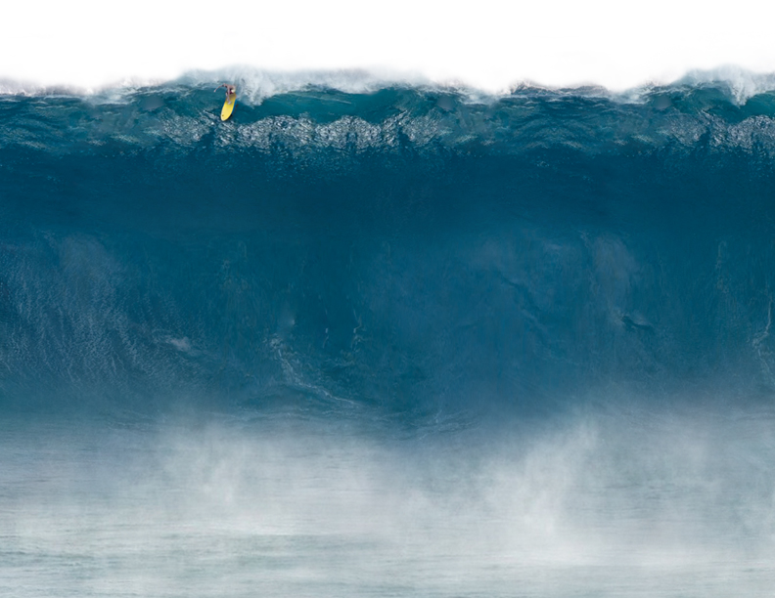
1 Peter 3:11-12
Today’s English Version
Since everything on earth will be gone one day, what kind of people should you be? Your lives should be holy and dedicated to God, as you wait for the day of God and do your best to make it come soon!

Slide 3
2 Peter 1:5-8
Contemporary English Version
Do your best to improve your faith. You can do this by adding goodness, understanding, self-control, patience, devotion to God, concern for others, and love. …

Slide 4
2 Peter 1:5-8
Contemporary English Version
… If you keep growing in this way, it will show that… Christ has made your lives useful and meaningful.

Slide 5
Proverbs 3:9-10
Honor God with everything you own; give Him the first and the best parts of everything. If you do this, your barns will fill with grain and your barrels will overflow with wine.

Slide 6
2 Timothy 2:3-7
New International Version / Living Bible
Endure hardship with us like a good soldier of Christ Jesus. No one serving as a soldier gets tied up in civilian affairs – he wants to please his commanding officer. Similarly, if anyone competes as an athlete,…

Slide 7
2 Timothy 2:3-7
New International Version / Living Bible
…he does not receive the victor’s crown unless he competes according to the rules. And the hardworking farmer should be the first to receive a share of the crops. …

Slide 8
2 Timothy 2:3-7
New International Version / Living Bible
… Think about these three illustrations, and the Lord will help you to understand how they apply to you.

Slide 9
1. I must define what I’d die for

Slide 10
John 15:13
New Living Translation
There is no greater love than to lay down one’s life for one’s friends.

Slide 11
2. I must sacrifice my comfort

Slide 12
2 Timothy 2:3
Endure hardship with us like a good soldier of Christ Jesus.

Slide 13
Ephesians 5:2
Live a life of sacrificial love just like Christ loved us and gave Himself as an offering and sacrifice for us.

Slide 14
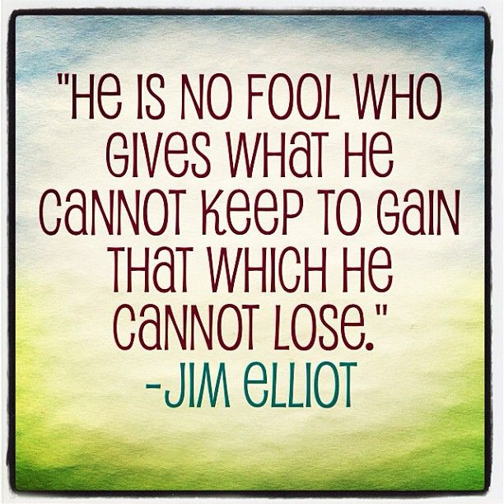

Slide 15
3. I must eliminate distractions

Slide 16
2 Timothy 2:4
New International Version / New Living Translation
As Christ’s soldier, do not let yourself become entangled in the affairs of this life, wasting time, for then you can’t please your commanding officer who enlisted you in his army.

Slide 17
2 Corinthians 9:24-27
New Living Translation
Don’t you realize that in a race everyone runs, but only one person gets the prize? So run to win! All athletes are disciplined in their training. They do it to win a prize that will fade away, but we do it for an eternal prize. …

Slide 18
2 Corinthians 9:24-27
New Living Translation
… So I run with purpose in every step. I am not just shadowboxing. I discipline my body like an athlete, training it to do what it should. Otherwise, I fear that after preaching to others I myself might be disqualified.

Slide 19
1. I must intend to win

Slide 20
1 Corinthians 9:24
Living Bible
In a race everyone runs, but only one person wins the prize. So run your race to win!

Slide 21
2 Timothy 4:7
New Living Translation
I have fought the good fight, I have finished the race, I have kept the faith.

Slide 22
1 Thessalonians 2:19-20
New Living Translation
After all, what gives us hope and joy, and what will be our proud reward and crown as we stand before our Lord Jesus when he returns? It is you! Yes, you are our pride and joy.

Slide 23
2. I must discipline myself

Slide 24
2 Timothy 2:5
New American Standard Bible
If anyone competes as an athlete, he cannot receive the victor’s crown unless he competes according to the rules.

Slide 25
1 Corinthians 9:25, 27
New Living Translation
All athletes are disciplined in their training. They do it to win a prize that will fade away, but we do it for an eternal prize. … I discipline my body like an athlete, training it to do what it should.

Slide 26
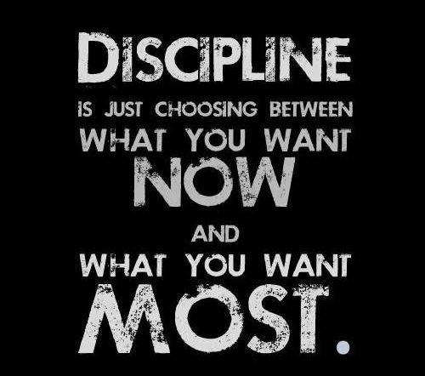

Slide 27
3. I must stay focused on the reward

Slide 28
Hebrews 12:1b-2
New Living Translation
And let us run with endurance the race God has set before us. We do this by keeping our eyes on Jesus, the champion who initiates and perfects our faith. Because of the joy awaiting him, he endured the cross, disregarding its shame.

Slide 29
Hebrews 12:2
New Living Translation
… Now he is seated in the place of honor beside God’s throne.

Slide 30
1 Corinthians 9:26
Living Bible
I run straight to the goal with purpose in every step! I fight to win. I’m not just shadow-boxing or playing around.

Slide 31
2 Corinthians 9:6-13
New Living Translation
Remember this – a farmer who plants only a few seeds will get a small crop. But the one who plants generously will get a generous crop. You must each make up your own mind as to how much you should give. …

Slide 32
2 Corinthians 9:6-13
New Living Translation
… Don’t give reluctantly or in response to pressure. For God loves the person who gives cheerfully. Then God will generously provide all you need, and you will always have everything you need and plenty left over to share with others. …

Slide 33
2 Corinthians 9:6-13
New Living Translation
… For God is the one who gives seed to the farmer and then bread to eat. In the same way, He will give you many opportunities to do good, and He will produce a great harvest of generosity in you! …

Slide 34
2 Corinthians 9:6-13
New Living Translation
… Yes, you will be enriched so that you can give even more generously! …You will be glorifying God through your generous gifts, and your generosity will prove you are obedient to the Good News of Christ!

Slide 35
TO REAP A GREAT HARVEST, I MUST…
Plant generously in faith

Slide 36
Matthew 6:31-33
New Living Translation
So don’t worry about these things, saying, ‘What will we eat? What will we drink? What will we wear?’ These things dominate the thoughts of unbelievers, but your heavenly Father already knows all your needs. …

Slide 37
Matthew 6:31-33
New Living Translation
… Seek the Kingdom of God above all else, and live righteously, and he will give you everything you need.

Slide 38
Mark 10:29-30
I guarantee you this: Anyone who gives up anything for my sake and the Good News – whether a home or a family member or property – will get more than that back, multiplied a hundredfold, and in the world to come they will be given life forever!

