Slide 1

PART 04:
Daring to Imagine

Slide 2
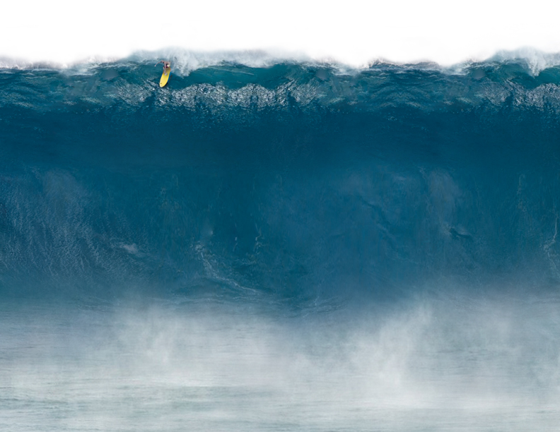
1. My imagination shapes my life

Slide 3
Proverbs 23:7
King James Version
…For as a man thinks in his heart, so he is.

Slide 4
“Imagination is more important than knowledge…Logic will get you from A to B. Imagination will take you everywhere. The true sign of intelligence is not knowledge but imagination.”
-Albert Einstein

Slide 5
“Imagination is the beginning of creation, you IMAGINE what you desire, you WILL create what you imagine, and you CREATE what you will.”
-George Bernard Shaw

Slide 6
“Imagination is the organ of meaning.”
-C.S. Lewis

Slide 7
“Imagination rules the world.”
-Napoleon Bonaparte

Slide 8
“Imagination decides everything.”
-Pascal

Slide 9
“If you can imagine it, you can achieve it. If you can dream it, you can become it!”
-William Arthur Ward

Slide 10
“You can’t do it unless you imagine it.”
-George Lucas

Slide 11
“Disneyland will never be completed. It will continue to grow as long as there is imagination left in the world.”
-Walt Disney

Slide 12
Genesis 11:6
Amplified Bible
The Lord said, ‘Now that they are one people speaking one language, this is only the beginning of what they will do. Now nothing they have imagined they can do will be impossible for them!’

Slide 13
2. Imagination is essential to living by faith

Slide 14
Hebrews 11:1
New Living Translation
What is faith? It is the confident assurance that what we hope for is going to happen. It is the evidence of things we cannot yet see.

Slide 15
2 Corinthians 4:18
New Century Version
We set our eyes not on what we see but on what we cannot see. What we see will only last a short time, but what we cannot see will last forever.

Slide 16
3. Great lives are built around great dreams

Slide 17
Ephesians 1:18
New American Standard Bible
“I pray that the eyes of your heart may be enlightened, so that you will know what is the hope of His calling…”

Slide 18
Proverbs 29:18
King James Version
Where there is no vision, the people perish…

Slide 19
4. God’s dream for my life is bigger than my dream

Slide 20
Ephesians 3:20
New Living Translation
Now all glory to God, who is able, through his mighty power at work within us, to accomplish infinitely more than we might ask or think.

Slide 21
Let the size of my God, determine
the size of my goals

Slide 22
5. Doubt is the enemy of imagination

Slide 23
James 1:5-7
But if any of you needs wisdom, you should ask God for it. He is generous to everyone and will give you wisdom without criticizing you. But when you ask God, you must believe and not doubt. Anyone who doubts is like a wave in the sea, …

Slide 24
James 1:5-8
New Century Version
… blown up and down by the wind. Such doubters are thinking two different things at the same time, and they cannot decide about anything they do. They should not think they will receive anything from the Lord.

Slide 25
Mark 9:22-24
New Living Translation
The man said, ‘Please heal my son if you can.’ Jesus replied, ‘What do you mean, “If I can?” Anything is possible if the person believes.’ The father replied, ‘I do believe, but help me not to doubt!’

Slide 26
6. God’s Spirit & God’s Word fuel
my imagination

Slide 27
John 14:16-17
New International Version
And I will ask the Father, and He will give you another advocate to help you and be with you forever - the Spirit of Truth… you know him, for he lives with you and will be in you!

Slide 28
Psalm 119:18, 27
New Living Translation
Open my eyes to see the wonderful truths in Your law…Help me understand the meaning of Your commandments, and I will meditate on Your wonderful miracles.

Slide 29
The Key: A DAILY QUIET TIME

Slide 30
Isaiah 50:4
New Living Translation
The Sovereign Lord has given me His words of wisdom, so I know what to say to all these weary ones. Morning by morning He wakens me and opens my understanding to His will.

Slide 31
7. Growing my character will
clarify my vision

Slide 32
2 Peter 1:5-9
New Living Translation
Supplement your faith with a generous provision of moral excellence, and moral excellence with knowledge, and knowledge with self-control, and self-control with patient endurance, and patient endurance with godliness…

Slide 33
2 Peter 1:5-9
New Living Translation
…and godliness with brotherly affection, and brotherly affection with love for everyone. The more you grow like this, the more productive and useful you will be in your knowledge of our Lord Jesus Christ. …

Slide 34
2 Peter 1:5-9
New Living Translation
…But those who fail to develop in this way are short-sighted or blind, forgetting that they have been cleansed from their old sins.

Slide 35
8. If a dream is from God, it will be connected somehow to His church & plan for the world

Slide 36
Mark 8:35
New Living Translation
If you try to keep your life for yourself, you will lose it. But if you give up your life for my sake and for the sake of the Good News, you will find true life.

