Slide 1
PART 6:
Daring to Plant in Faith

Slide 2
Genesis 8:22
New International Version
As long as the earth endures, there will be seedtime and harvest…

Slide 3
Galatians 6:7
New Living Translation
Don’t be misled – you cannot mock the justice of God. You will always harvest what you plant.

Slide 4
What goes around, comes around
You reap what you sow
You made your bed, now you have to lie in it.
When you do the wrong thing it often comes back to bite you.

Slide 5
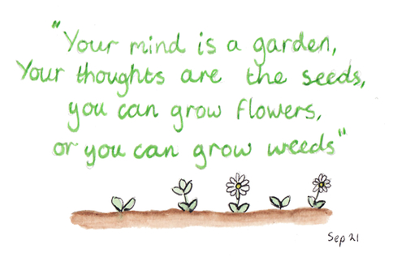

Slide 6
1. Everything starts as a seed

Slide 7
Genesis 1:11
God said, ‘Let the land have seed-bearing plants and trees that bear fruit with seed in it, according to their varieties.’

Slide 8
A “seed” is anything valuable
that I give away.

Slide 9
2. Nothing happens until a seed is planted

Slide 10
John 12:24
Jesus said, “Unless a grain of wheat is buried in the ground, it cannot reproduce. But if it dies, it will produce much fruit.”

Slide 11
Mark 4:26-27
New Century Version
Jesus said, ‘The Kingdom of God is like someone who plants seed in the ground. Night and day, whether the person is asleep or awake, the seed still grows, but the person does not know how it grows.’

Slide 12
3. When I have a need, I should plant a seed

Slide 13
Ecclesiastes 11:6
Today’s English Version
Do your planting in the morning and in the evening, too! You never know whether it will all grow well or whether one planting will do better than the other.

Slide 14
4. Whatever I plant is what I will harvest

Slide 15
Galatians 6:7b
New Living Translation
You always harvest what you plant.

Slide 16
Job 4:8
New Century Version
People who plant trouble, harvest it.

Slide 17
Proverbs 22:8
New Living Translation
Those who plant seeds of injustice will harvest disaster…

Slide 18
Hosea 10:13
You planted wickedness and now you reaped evil…

Slide 19
Matthew 7:2
New Living Translation
Whatever measure you use to judge others, will be used to measure how you are judged!

Slide 20
Proverbs 11:8
English Standard Version
The one who sows righteousness will reap a sure reward.

Slide 21
Hosea 10:12
New Living Translation
Plant the good seeds of righteousness, and you will harvest a crop of my love.

Slide 22
James 3:18
New Living Translation
Peacemakers plant seeds of peace and reap a harvest of goodness.

Slide 23
Galatians 6:7b-8
New Living Translation
You will always harvest what you plant. Those who live only to satisfy their own sinful nature will harvest decay and death from that sinful nature. …

Slide 24
Galatians 6:7b-8
New Living Translation
…But those who live to please the Spirit will harvest everlasting life from the Spirit.

Slide 25
5. I’m not the only one planting

Slide 26
John 4:38
I sent you to reap where you didn’t plant; others had already done work before you, and you will gather the harvest.

Slide 27
6. I always harvest in a different season than I plant

Slide 28
Ecclesiastes 3:1-5
There is a time for everything, and a season for every activity under Heaven… A time to plant and a time to harvest… a time to scatter and a time to gather…

Slide 29
7. I must be patient & not give up

Slide 30
Galatians 6:9
New Living Translation
So let’s not get tired of doing what is good. At just the right time we will reap a harvest of blessing if we don’t give up.

Slide 31
8. I always harvest more than I plant

Slide 32
Mark 4:8
Some seed fell on good soil. It came up, grew and produced a crop, multiplying thirty, sixty, and even a hundred times.

Slide 33
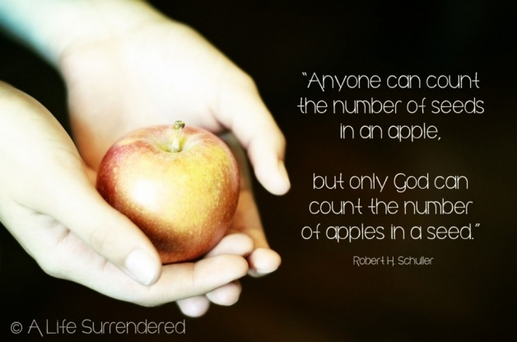

Slide 34
9. I can increase my harvest by planting
more seed

Slide 35
2 Corinthians 9:6-7
Remember this: Whoever sows sparingly will reap sparingly, and whoever sows generously will reap generously. Each one should give what he’s decided in his heart to give, not reluctantly or under compulsion, for God loves a cheerful giver.

Slide 36
Proverbs 11:24
New Living Translation
Give freely and become more wealthy;
be stingy and lose everything.

Slide 37
10. The more seed I plant, the more
God will give me

Slide 38
2 Corinthians 9:10
Living Bible
For God, who supplies seed to the farmer and bread to eat, will give you more and more seed to plant and will make it grow so that you can give away more and more fruit from your harvest!

Slide 39
11. I plant by faith, not by my feelings

Slide 40
Psalm 126:5-6
New Living Translation
Those who plant in tears will harvest with shouts of joy. They weep as they go to plant their seed, but they sing as they return with the harvest.

Slide 41
12. The best time to plant is now

Slide 42
Ecclesiastes 11:4
Those who wait for perfect weather will never plants seeds; and those who look at every cloud will never reap a harvest.

