Slide 1

WEEK 02:
How to Get Ready For a Miracle

Slide 2
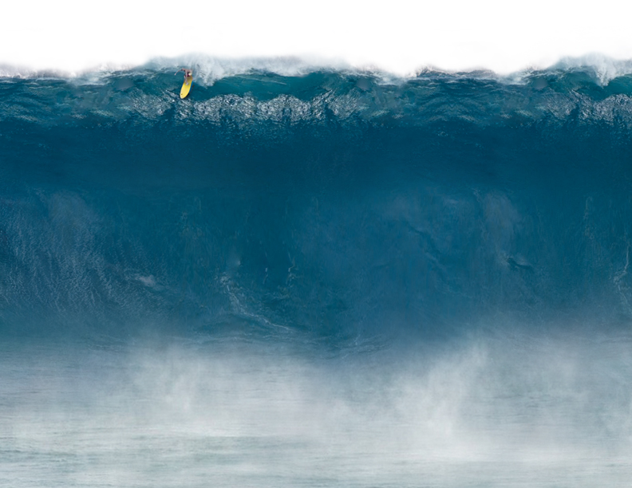
Colossians 2:7
New Living Translation
Let your roots grow down into Him and draw up nourishment from Him, so that you will grow in faith, strong and vigorous…

Slide 3
2 Corinthians 9:6
Remember this: Whoever sows sparingly will also reap sparingly, and whoever sows generously will also reap generously.

Slide 4
Hebrews 11:8
New Century Version
It was by faith Abraham obeyed God’s call to go to another place God promised to give him. He left his own country, without knowing where he was to go.

Slide 5
Hebrews 11:6
New International Version
Without faith it is impossible to please God…

Slide 6
Romans 14:23b
New International Version
…and everything that does not come from faith is sin.

Slide 7
Matthew 9:29
New International Version
According to your faith will it be done to you.

Slide 8
3 PURPOSES:
1. To advance our spiritual maturity by stretching our faith.

Slide 9
James 1:3-4
New Living Translation
When your faith is tested, your endurance has a chance to grow. So let it grow, for when your endurance is fully developed, you’ll be strong in character and ready for anything!

Slide 10
3 PURPOSES:
2. To enhance our relational unity by cooperating together.

Slide 11
Acts 4:32-35
The believers in the Jerusalem church were united in their hearts and spirit because they shared all they had with each other… In fact, people would sell what they owned, even their homes, and give the money as an offering.

Slide 12
3 PURPOSES:
3. To finance our local and global ministry.

Slide 13
2 Corinthians 10:15b
Message
What we’re hoping for is that as your lives grow in faith, you’ll play a greater part within our expanding work.

Slide 14
2 Corinthians 8:7
Since you already excel in so many ways – you have so much faith, such gifted teaching, so much knowledge, so much enthusiasm, and so much love – now I want you to grow and excel in the ministry of generous giving.

Slide 15
WHAT WE WON’T DO:
1. We won’t pressure anyone to give

Slide 16
2 Corinthians 9:7
Each one should give what he has decided in his heart to give, not reluctantly or under pressure, for God loves a cheerful giver.

Slide 17
WHAT WE WON’T DO:
2. We won’t sell anything

Slide 18
1 Chronicles 21:24
I will not sacrifice an offering that costs me nothing.

Slide 19
4 THINGS YOU CAN EXPECT DURING THE
DARING FAITH CAMPAIGN:
To see miracles
To grow spiritually
To be hassled by Satan
To experience joy

Slide 20
HOW FAITH IN JESUS TURNS A LITTLE INTO
A LOT:
Admit I have an unsolvable problem

Slide 21
Mark 6:34-37a
New International Version
When Jesus…saw a large crowd, He had compassion on them…so He began teaching them. By this time it was late in the day, so His disciples came and said, ‘This is a remote place. …

Slide 22
Mark 6:34-37a
New International Version
…Send the people away so they can go and buy something to eat.’ But Jesus answered, ‘You give them something to eat!’ They said, ‘That would take eight months of a man’s wages!’

Slide 23
HOW FAITH IN JESUS TURNS A LITTLE INTO
A LOT:
2. Give God what little I have

Slide 24
Mark 6:38
New International Version
‘How many loaves do you have?’ Jesus asked. ‘Go and see.’ When they found out, they said, ‘Five small loaves of bread and two fish.’

Slide 25
John 6:6
New International Version
Jesus asked this only to test them, for He already had in mind what He was going to do.

Slide 26
HOW FAITH IN JESUS TURNS A LITTLE INTO
A LOT:
3. Put it all in the hands of Jesus

Slide 27
Mark 6:41
New American Standard Bible
Jesus took the five loaves and the two fish…He blessed the food and broke the loaves and He kept giving them to the disciples to set before the people…

Slide 28
HOW FAITH IN JESUS TURNS A LITTLE INTO
A LOT:
4. Expect God to multiply it

Slide 29
Mark 6:42-43
Phillips
Everyone ate and had enough. Afterwards, they collected twelve baskets full of…leftovers!

Slide 30
Mark 10:27
New International Version
All things are possible with God.

Slide 31
John 12:24
A kernel of wheat must be given away and planted in the soil. Unless it dies and is buried, it will remain a single seed. But its death will produce many more seeds and a great harvest!

